Slide 1
Capstone Project
Retail and market analytics
-Anupam Barasia & Abhishek Das

Slide 2
AGENDA
Objective
Visualization
Recommendation
Appendix:
Data methodology

Slide 3
OBJECTIVE
OList is one such e-commerce company that has faced some losses recently and they want to manage their inventory very well so as to reduce any unnecessary costs that they might be bearing.
Need to identify top products that contribute to the revenue and also use market basket analysis to analyze the purchase behavior of individual customers to estimate with relative certainty, what items are more likely to be purchased individually or in combination with some other products.

Slide 4
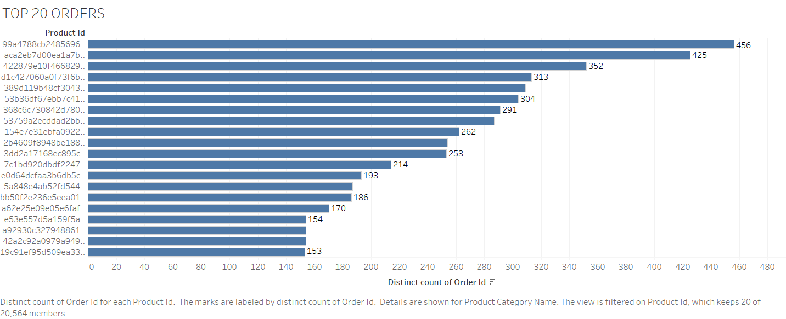

Slide 5
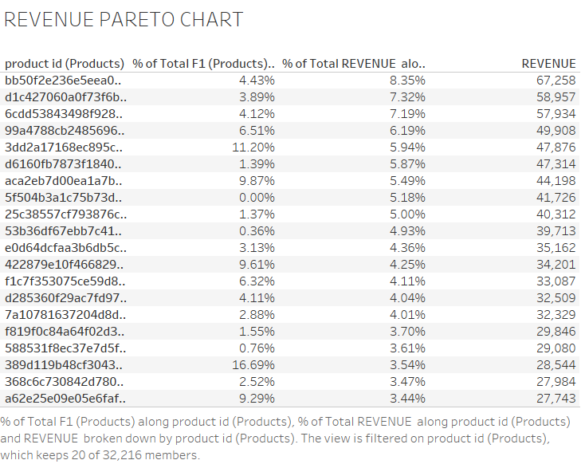
Percentage of total revenue and percentage of total product along with revenue for individual product is been shown by this Pareto chart

Slide 6
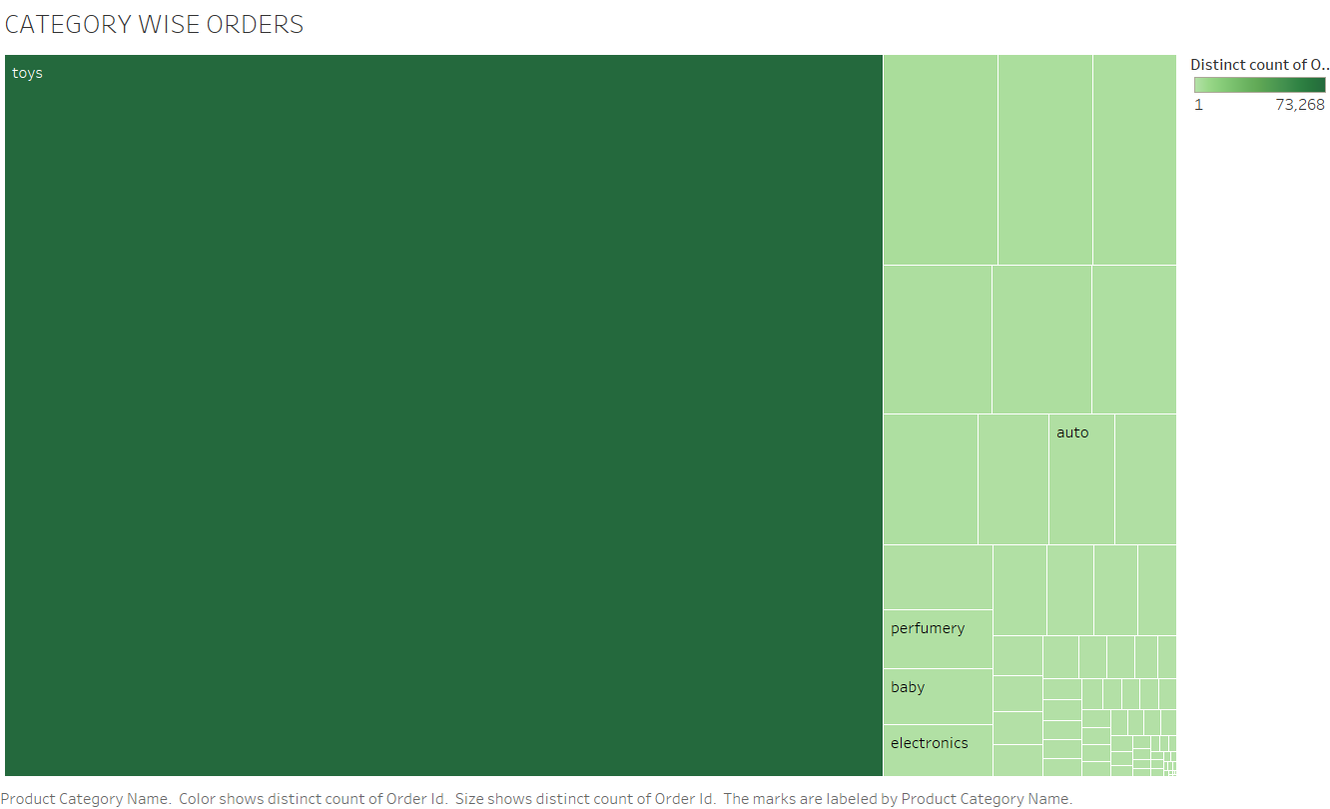


Slide 7
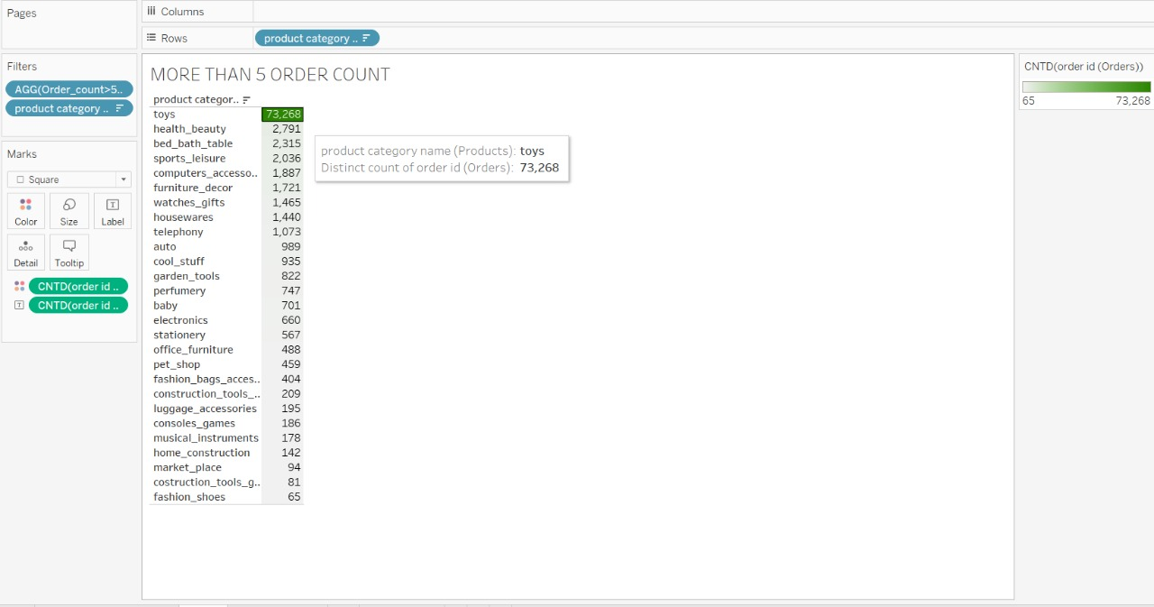
This chart tells us quantity of order which are more than 5
And toys product category has the maximum number of product ordered.

Slide 8
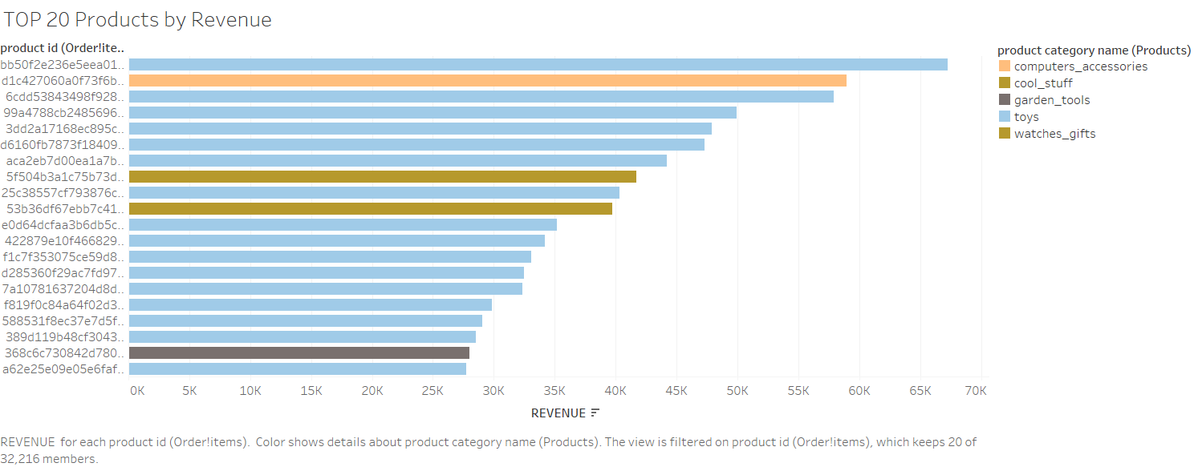
This bar chat shows us the top 20 products with respect to revenue .

Slide 9
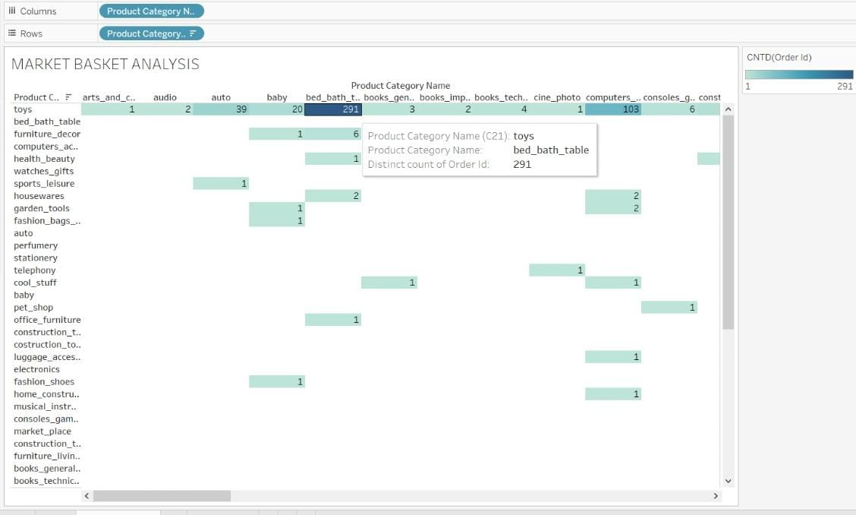
After combining the data we get bed_bath_table and toys has the highest distinct count of orders which is 291 .

Slide 10
Recommendation
To put some good offers and discounts to attract more customers .
Customers purchasing frequently should be provided with some exclusive offers and benefits to them.
Customers who are more towards buying toys should be targeted.

Slide 11
APPENDIX - Methodology:
I have conducted a thorough analysis of the Olist data. The process includes:
Cleaning the data set using numpy through jupyter notebook.
Using tableau desktop I have generated the different visualization to get the meaningful insights.

